Slide 1


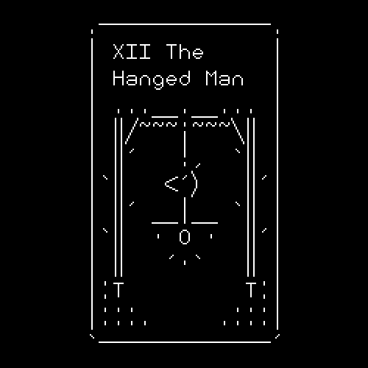
Guess The Country Game
By– Co21332(Karandeep Singh)
Co21330(Karan Sharma)
Submitted To :
Dr. Sarabjeet Singh

Slide 2


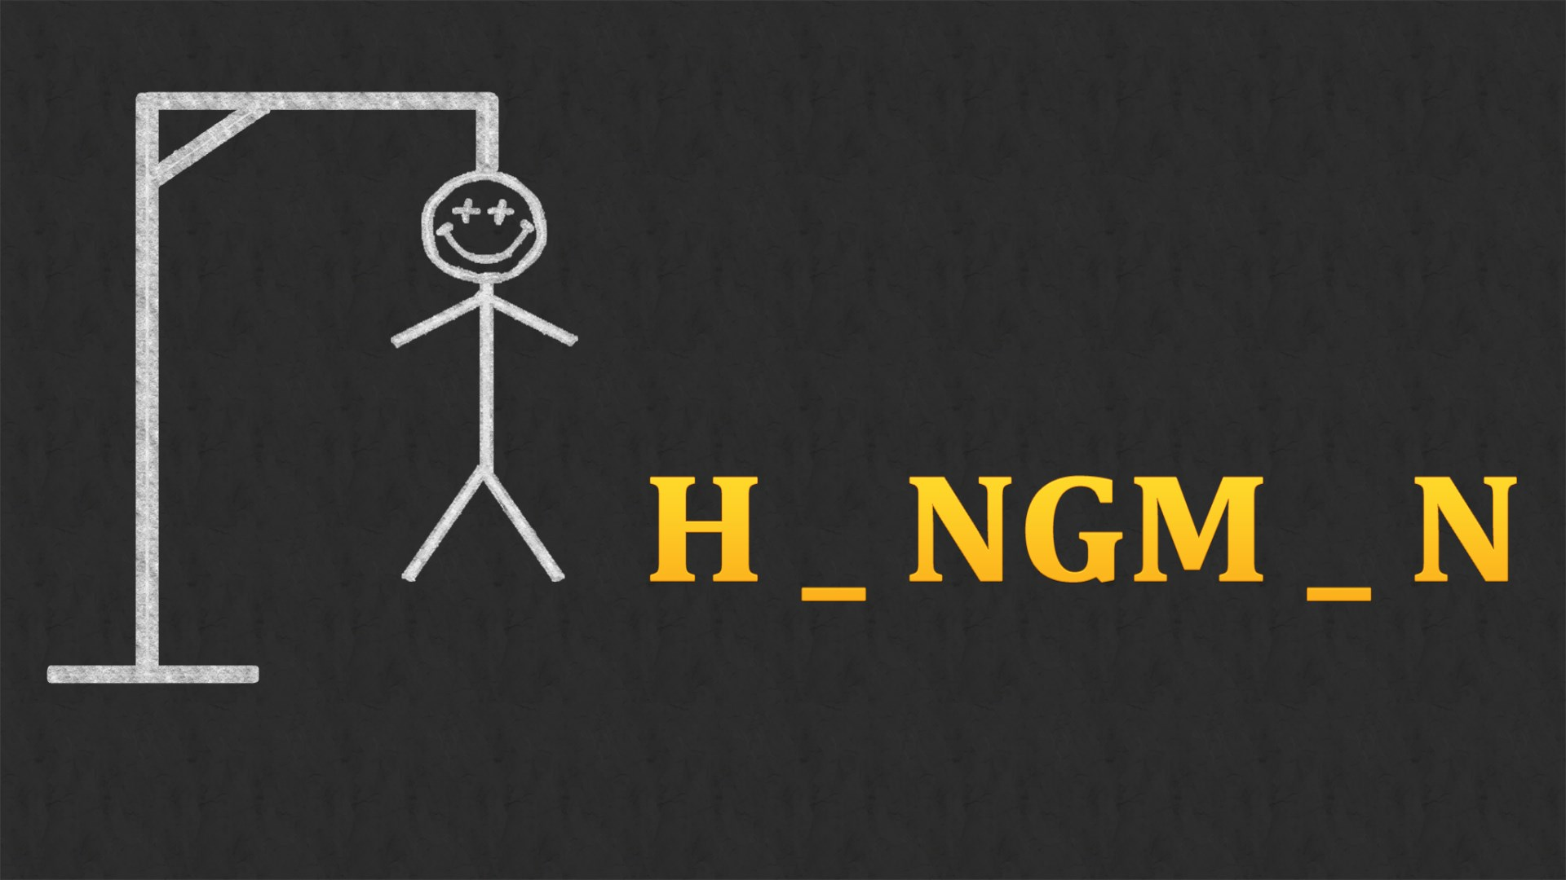
BASIC PRINCIPLE OF THE GAME :-
This game is based upon the simple principle of Hangman Game. Hangman is a popular word guessing game where the player attempts to build a missing word by guessing one letter at a time. After a certain number of incorrect guesses, the game ends and the player loses. The game also ends if the player correctly identifies all the letters of the missing word.

Slide 3
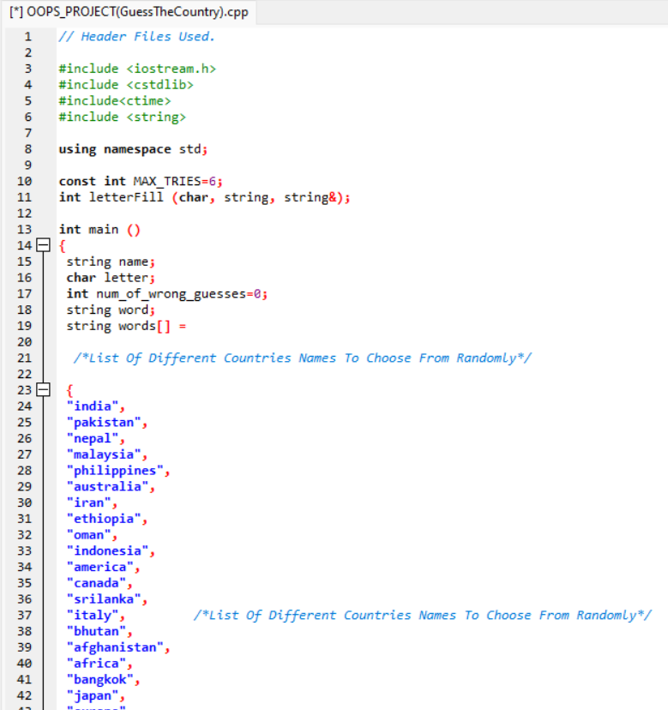
CODE OF THE PROGRAM
Here we have used the following header files in the program.
#include <iostream>
#include <cstdlib>
#include <ctime>
#include <string>
<cstdlib> specifies a fundamental collection of operations for dealing with wide or multibyte characters, pseudo-random number generation, memory allocation, searching, sorting, and mathematics.
<ctime> returns a string representing the localtime based on the argument timer.
Next, we have initialized the max tries(i.e = 6) and other variables.
Next, we have entered some names of different countries all over the world. The function will select at random any country’s name and then the user has to guess it.

Slide 4
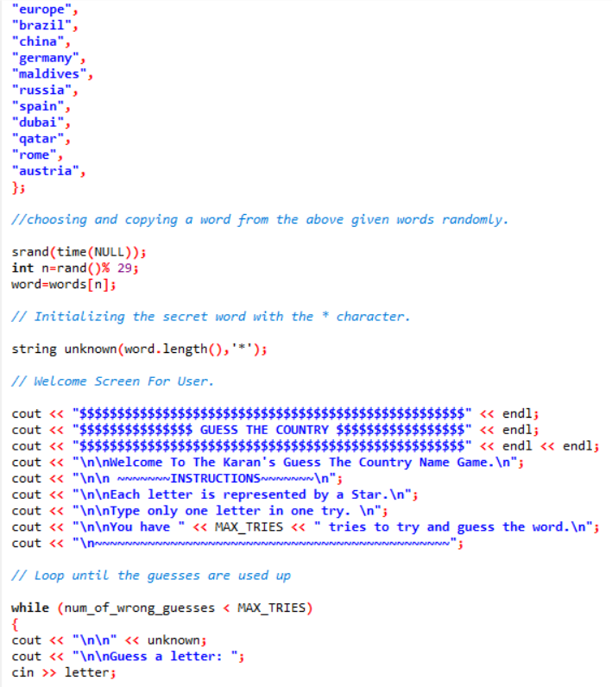
CODE OF THE PROGRAM
Srand(time(NULL));
Here, we have used the Srand() function which is used to initialise random number generators. This function is defined in the <cstdlib> library and it picks the name of a country randomly from the given list of 29 countries.
String unknown(word.length(), ’ * ’);
This gives the output in such a way that if a country has 7 letter in its name then it will display 7 stars in place of letters so that the user guesses it.
Next, we have made the welcome screen for the user. Basically the title page of the game.
It gives the user certain sets of instructions that the user has to follow while playing the game.
Next, we have initialised the while loop, this loop gives the output as Guess a letter: until the wrong guesses are less than the Max Tries.

Slide 5
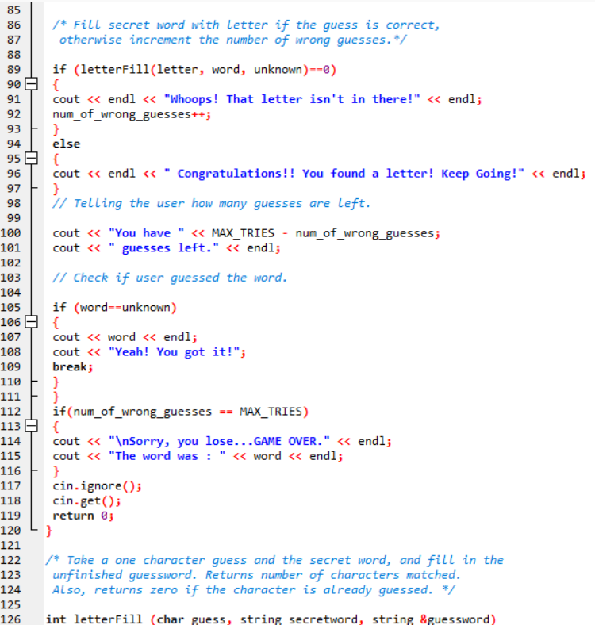
Guess The Country Game
Here, we have made an if loop that works when the input given from the user is wrong or the letter is not present in the given word which the user has to guess.
Else loop comes into play when the input letter entered by the user is present in the word to be guessed.
Next we have used the cout function to display the remaining number of chances of guessing the word.
Again, we used the if loop. This time the work of the if loop is to check if the inputted word is equal to or present in the word to be guessed. Then the cout function is used to display the place of the letter entered by the user.
If the number of wrong guesses become equal to the maximum tries then the compiler will display the word which was to be guessed with a message that Sorry, you lose…GAME OVER.
By – Co21332(Karandeep Singh)
Co21330(Karan Sharma)
Submitted To :
Dr. Sarabjeet Singh

Slide 6
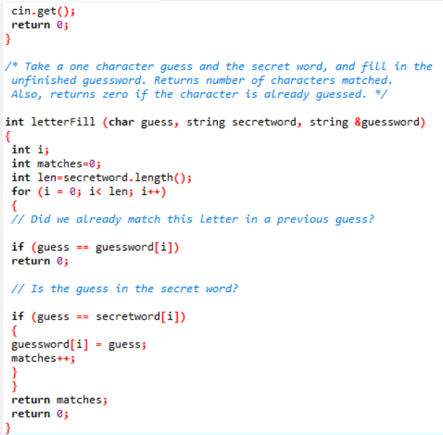
Guess The Country Game
This is the main and the most important part of our whole program. Here the int, char and string datatypes are used to fill the blank spaces represented by the stars in our function.
By – Co21332(Karandeep Singh)
Co21330(Karan Sharma)
Submitted To :
Dr. Sarabjeet Singh

Slide 7
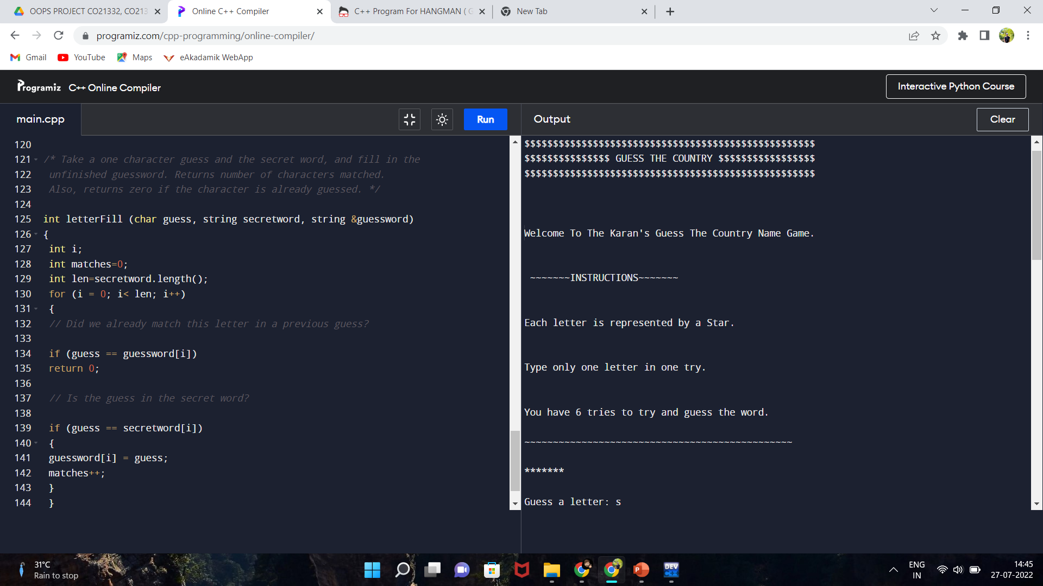
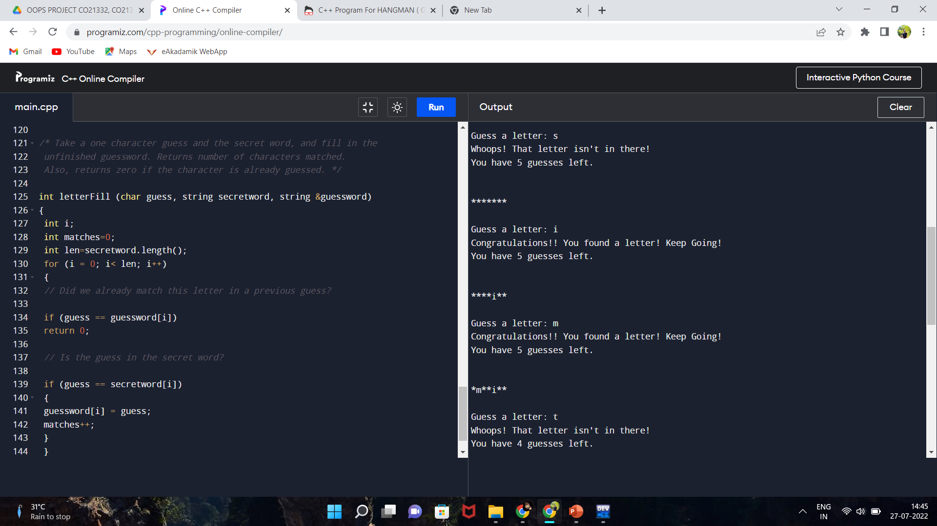
OUTPUTS OF THE FUNCTION

Slide 8
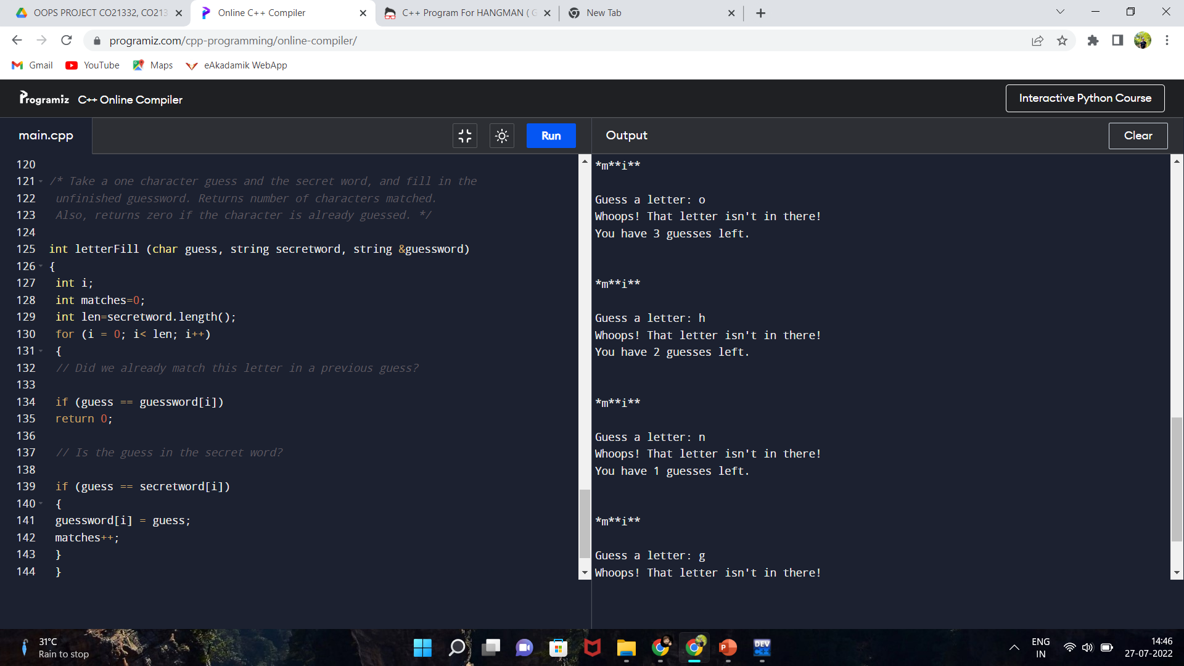
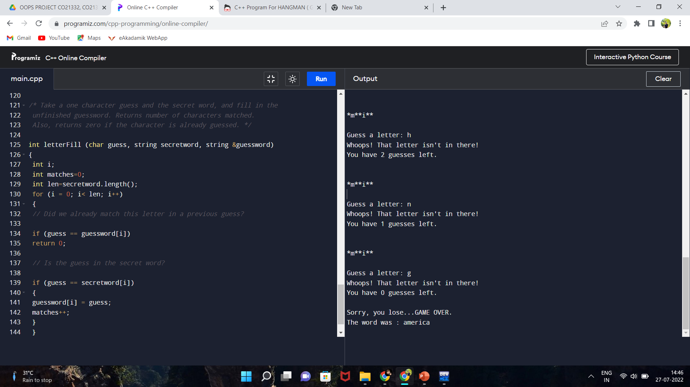
OUTPUTS OF THE FUNCTION
This is the output when the user is unable to guess the word i.e the country name.

Slide 9
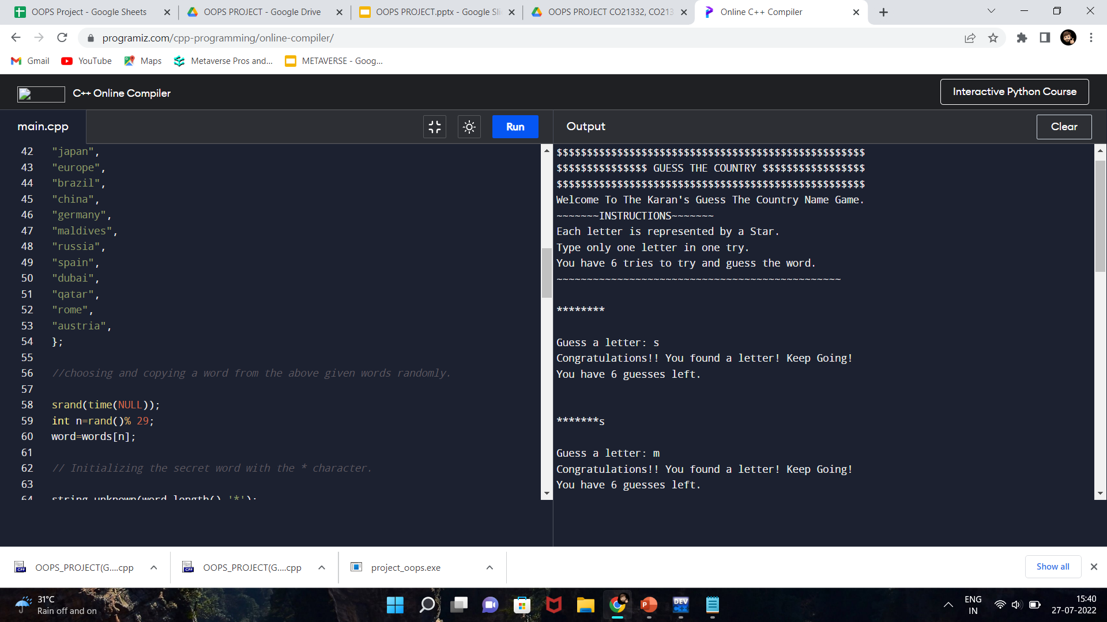
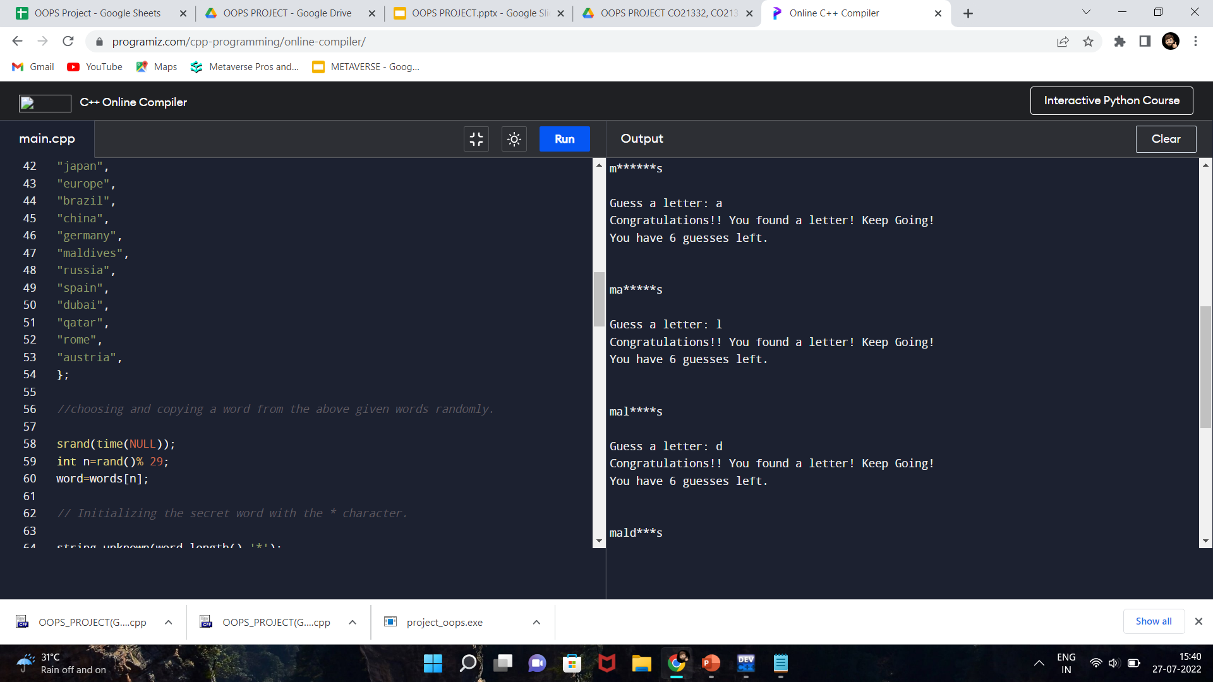
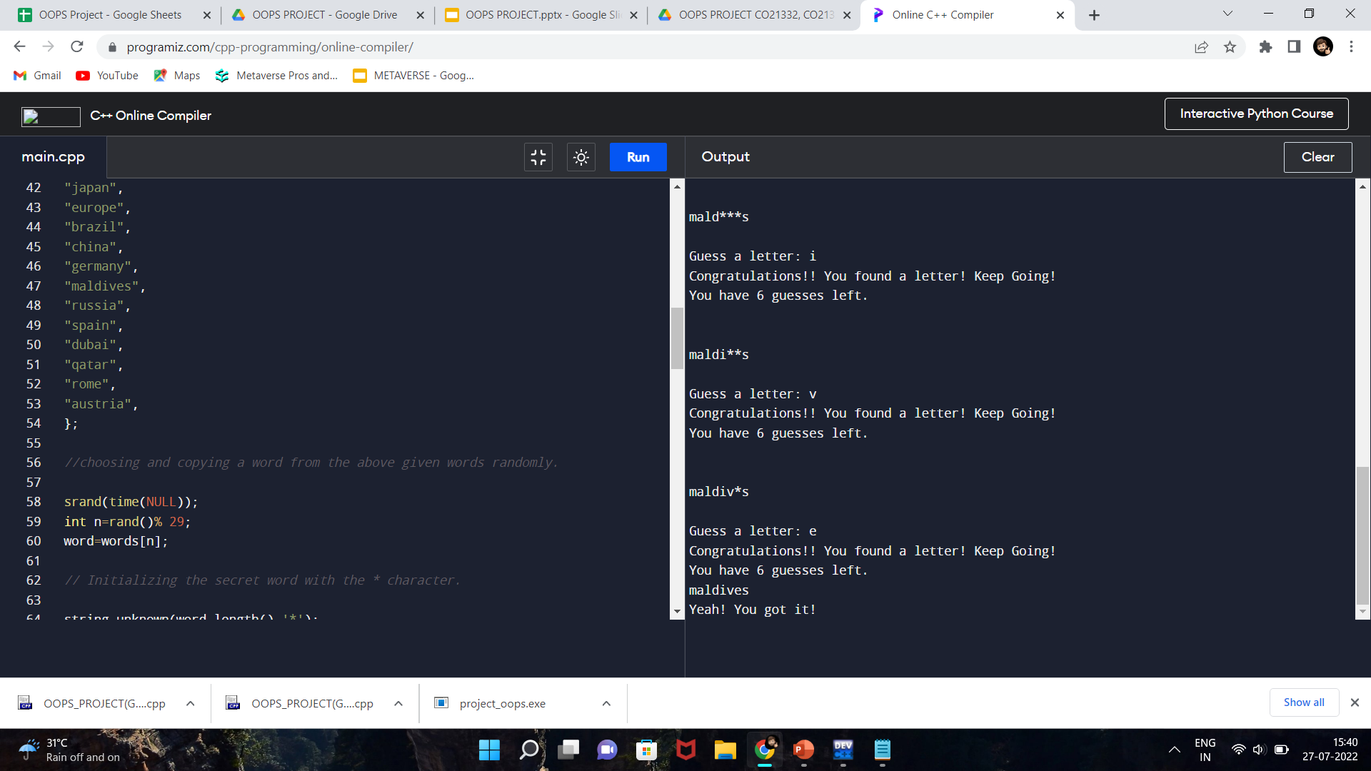
Outputs of the program
Output when the user guesses the word correctly.

Slide 10
Future improvements?
The number of players can be increased and it can be developed as a multiplayer game.
The names in the list from where the compiler randomly selects a word can be increased/decreased/changed as per the user requirements.
The user interface of the game can be improved by adding graphics.

Slide 11
THANK YOU!!

